Slide 1
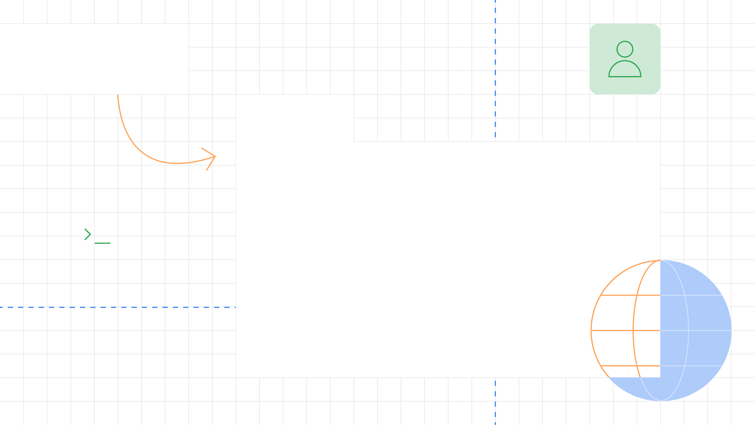



Introduction to Android Development
Merna Medhat
DSC Android Member

Slide 2

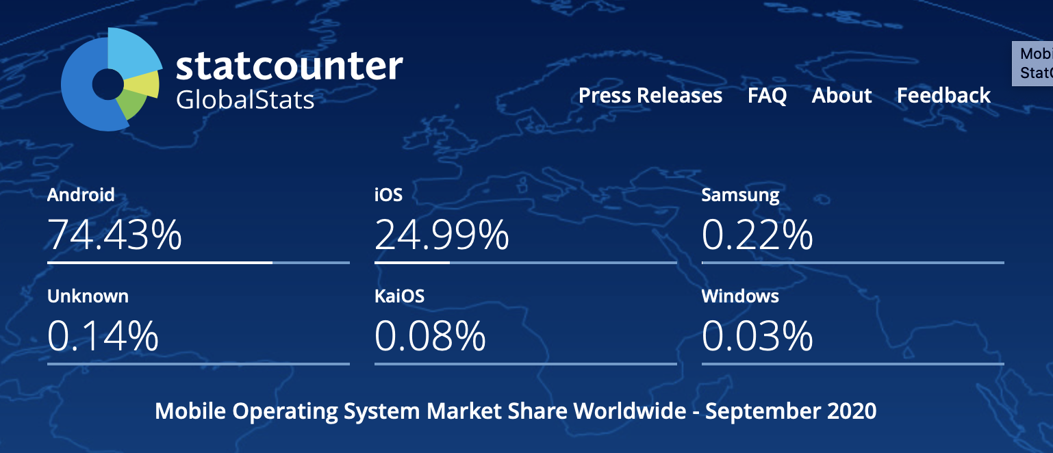


Operating systems market share
Notes:
Smart phones that works with android represents 75% of the smart phones wordwide When you publish Android app on the play store you reach 75% of the population

Slide 3
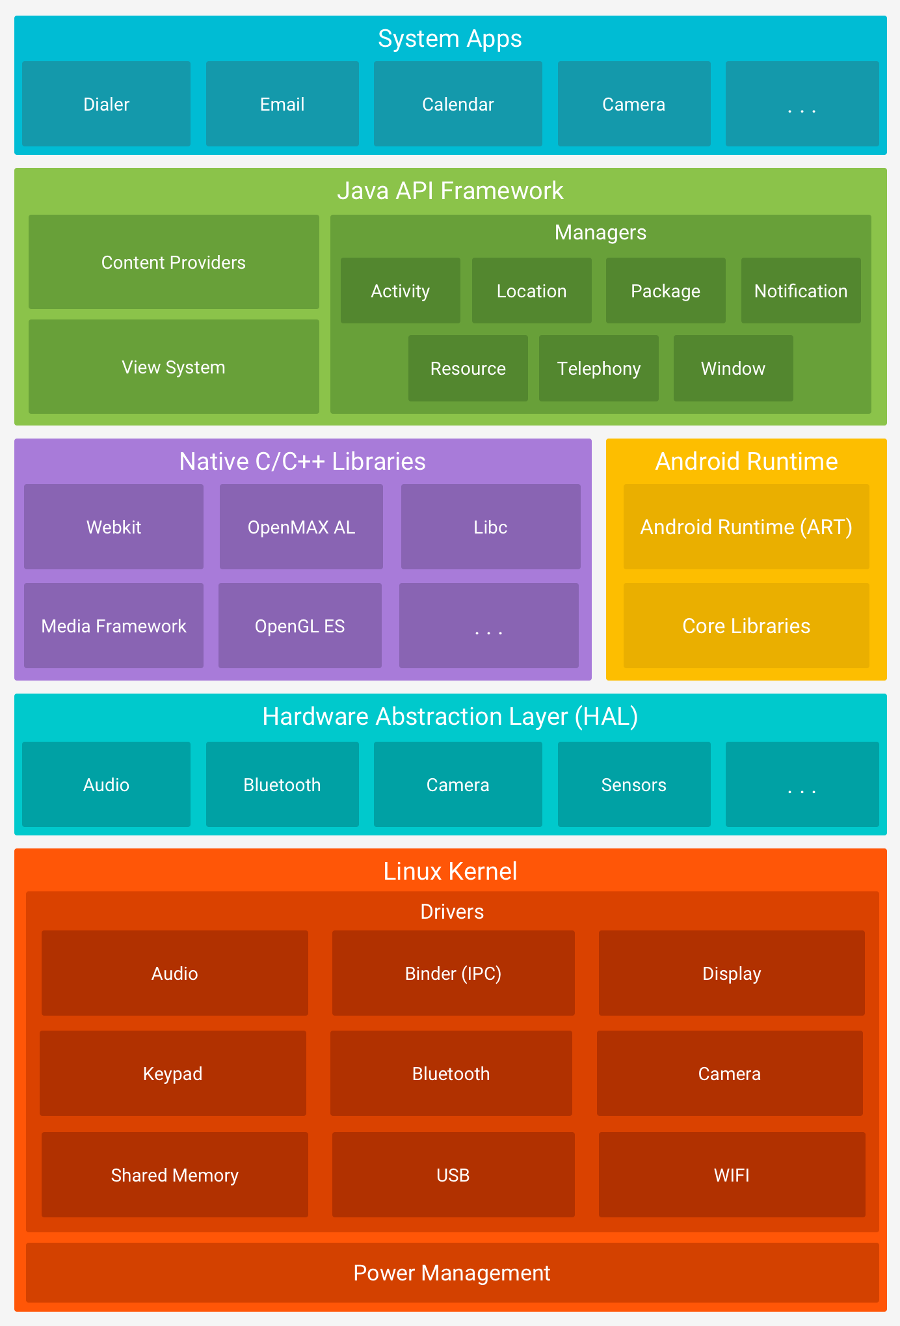
What is the Android?
Android is an open source, Linux-based software created for a wide array of devices
Linux Kernel
HAL
Native C/C++ Libraries
Java API Framework
System Apps

Slide 4
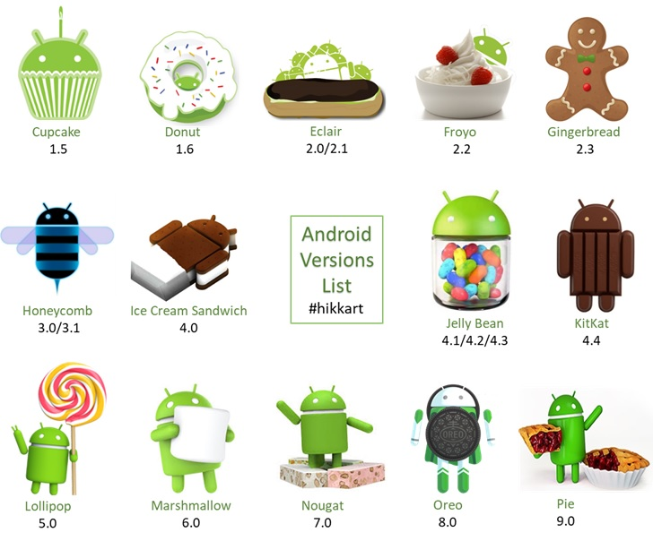

Slide 5

How we can develop android apps?

Slide 6
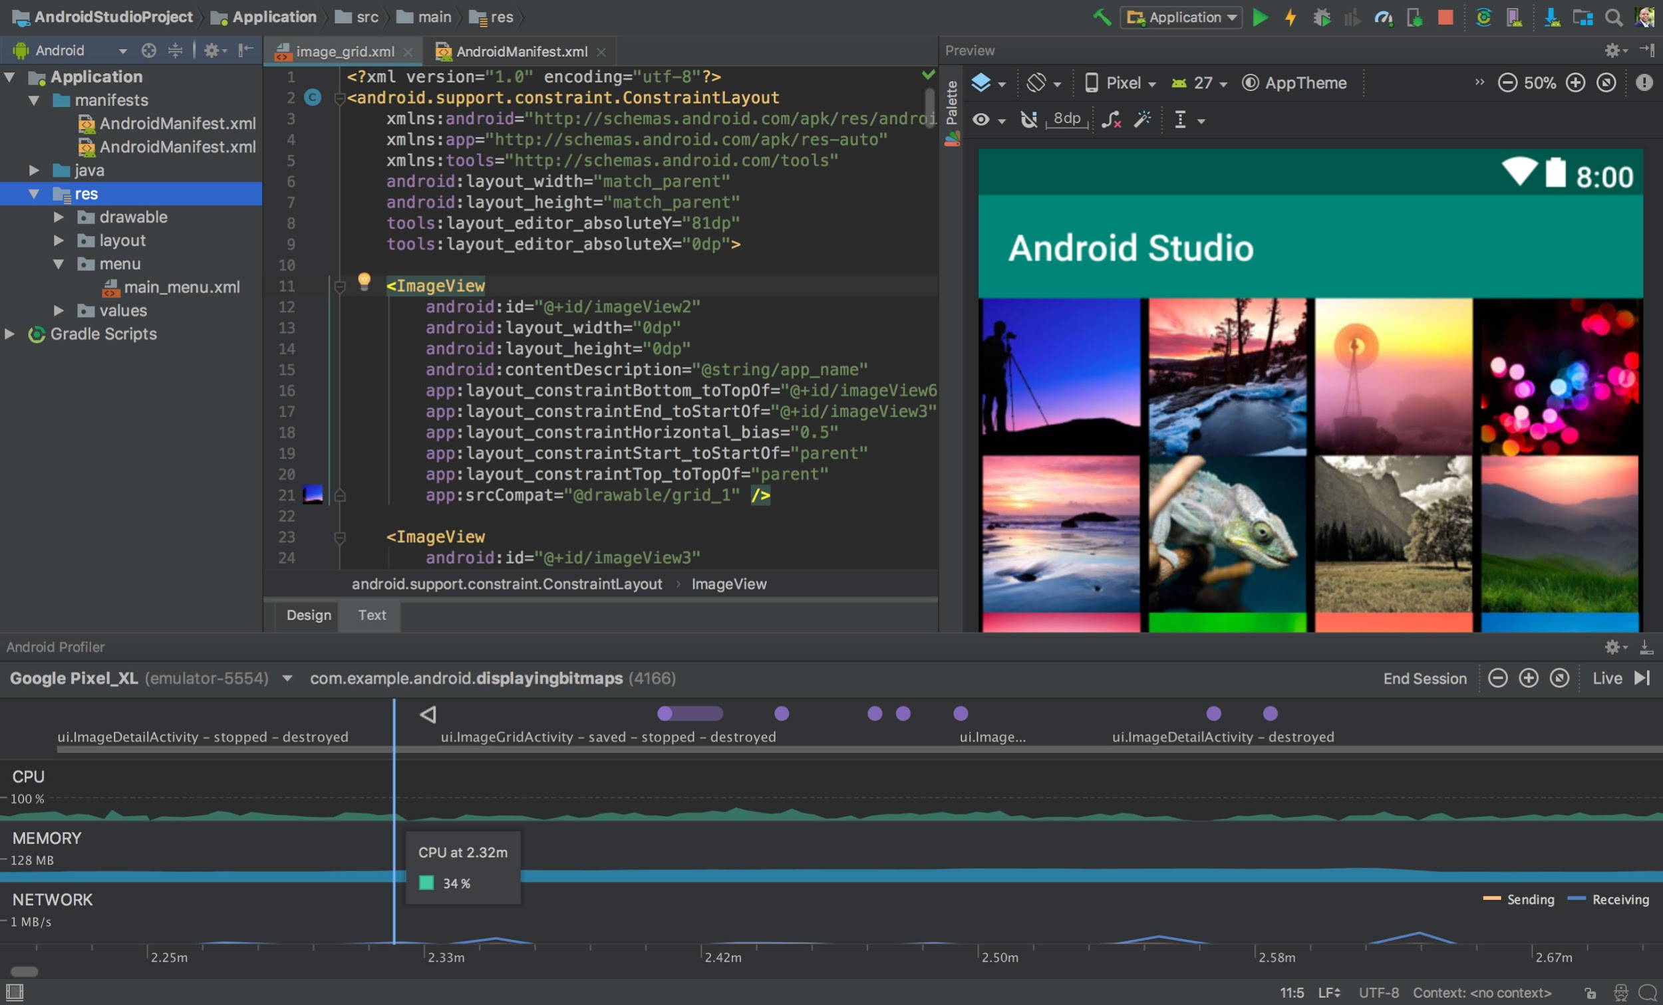
Notes:
New Project

Slide 7
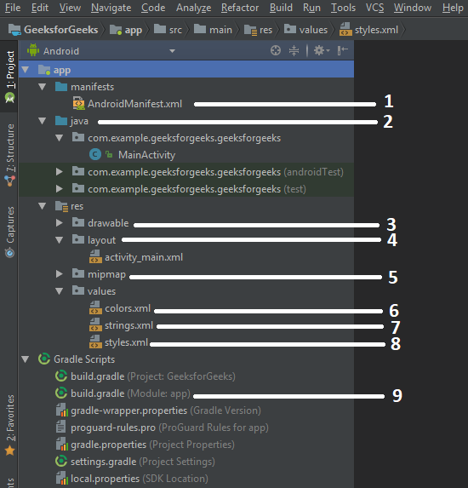
File Structure
manifest.xml
java package
drawable resource
layouts
mipmap
colors.xml
strings.xml
styles.xml
build.gradle

Slide 8
Android Screens
Design

Slide 9
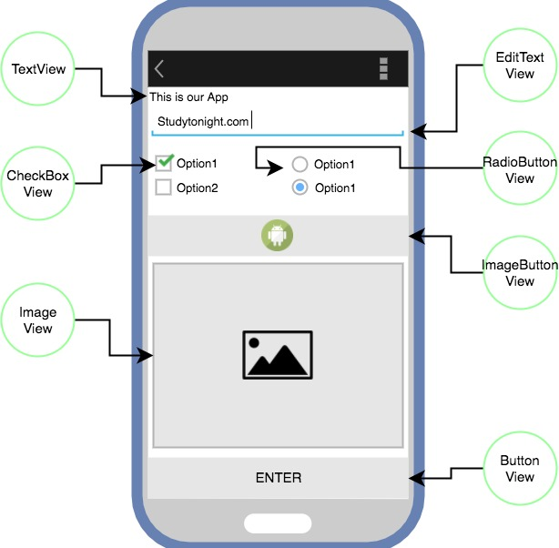
What is the View?
View is the basic building block of UI (User Interface )in android
Views refer to android.view.Viewclass, Which is super class for all the GUI Components like TextView, ImageView ...

Slide 10
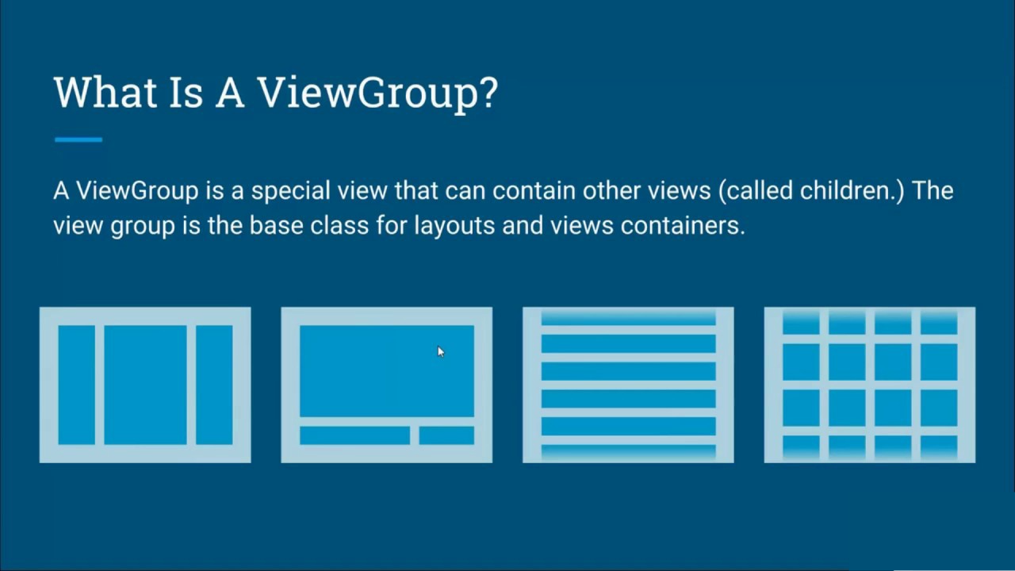

Slide 11
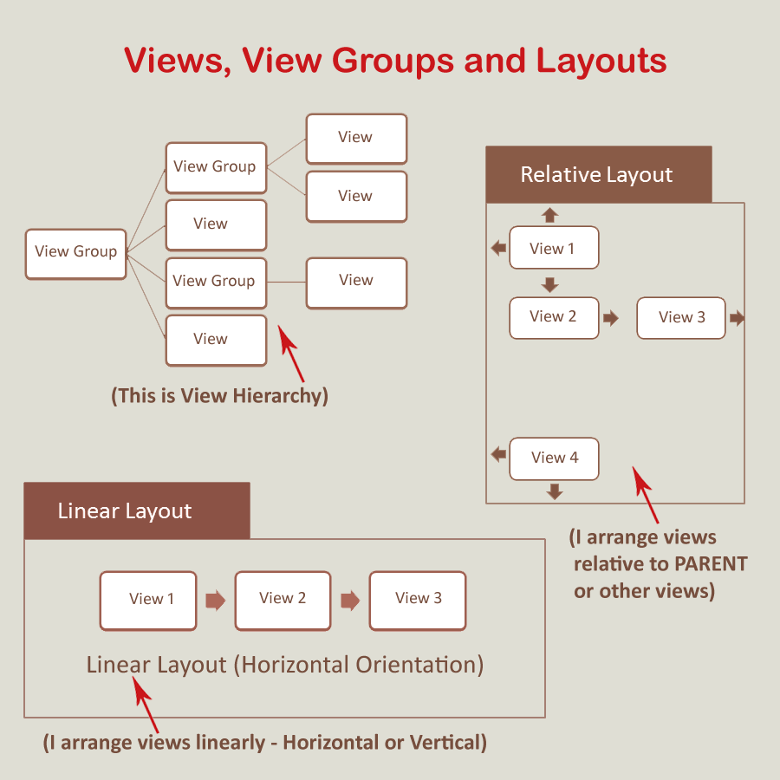
View Groups
Views
Linear Layout
Relative Layout
Constraint Layout
……. Much more
Button
TextView
EditText
……. Much more

Slide 12


Slide 13
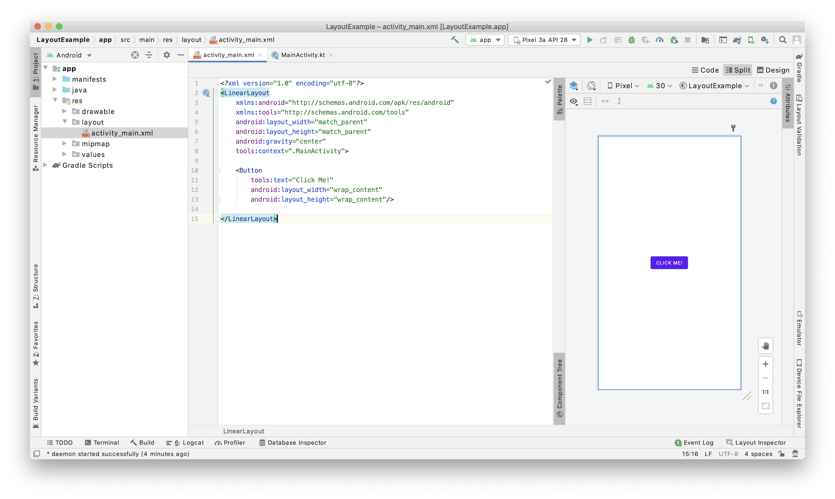

Slide 14
Layout Attributes
android:id: A unique ID that corresponds to the view.
android:layout_width: The width of the layout.
android:layout_height: The height of the layout.
android:layout_marginTop: Extra space on the top of the layout.
android:layout_marginBottom: Extra space on the bottom of the layout.
android:layout_marginLeft: Extra space to the left of the layout.
android:layout_marginRight: Extra space to the right of the layout.
android:paddingLeft: Padding to the left of the view.
android:paddingRight: Padding to the right of the view.
android:paddingTop: Padding at the top of the view.
android:paddingBottom: Padding at the bottom of the view.

Slide 15
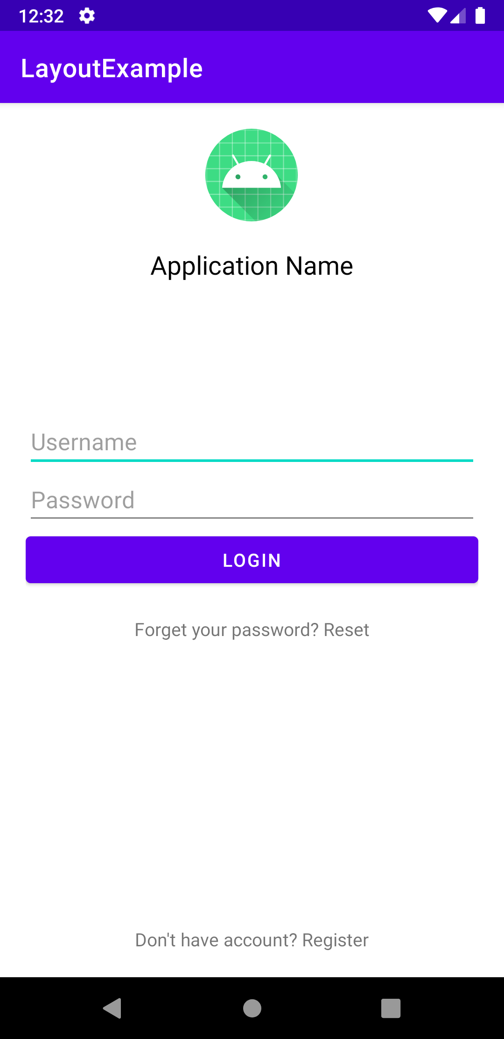
Let’s write some code
Login page components -> (Views)
App Logo (ImageView)
App Name (TextView)
Username (EditText)
Password (EditText)
Login (Button)
Reset password (TextView)
Register (TextView)

Slide 16
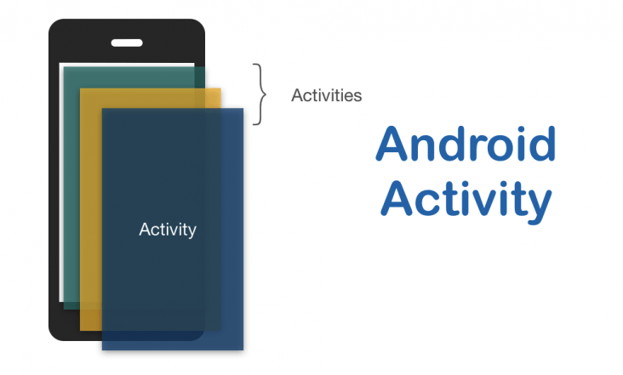
OnCreate
OnStart
OnResume
OnPause
Ontop
OnDestroy

Slide 17
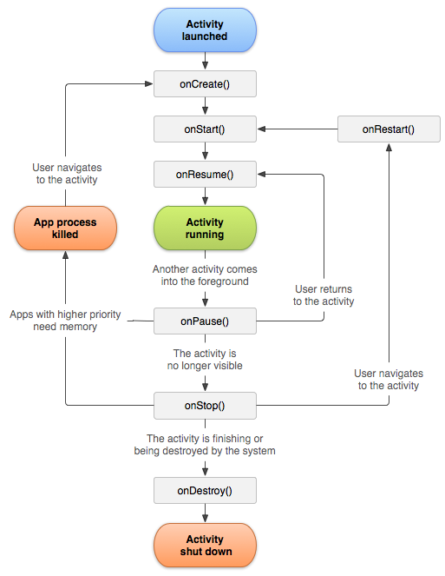
Activity lifecycle
OnCreate
OnStart
OnResume
OnPause
OnStop
OnDestroy

Slide 18
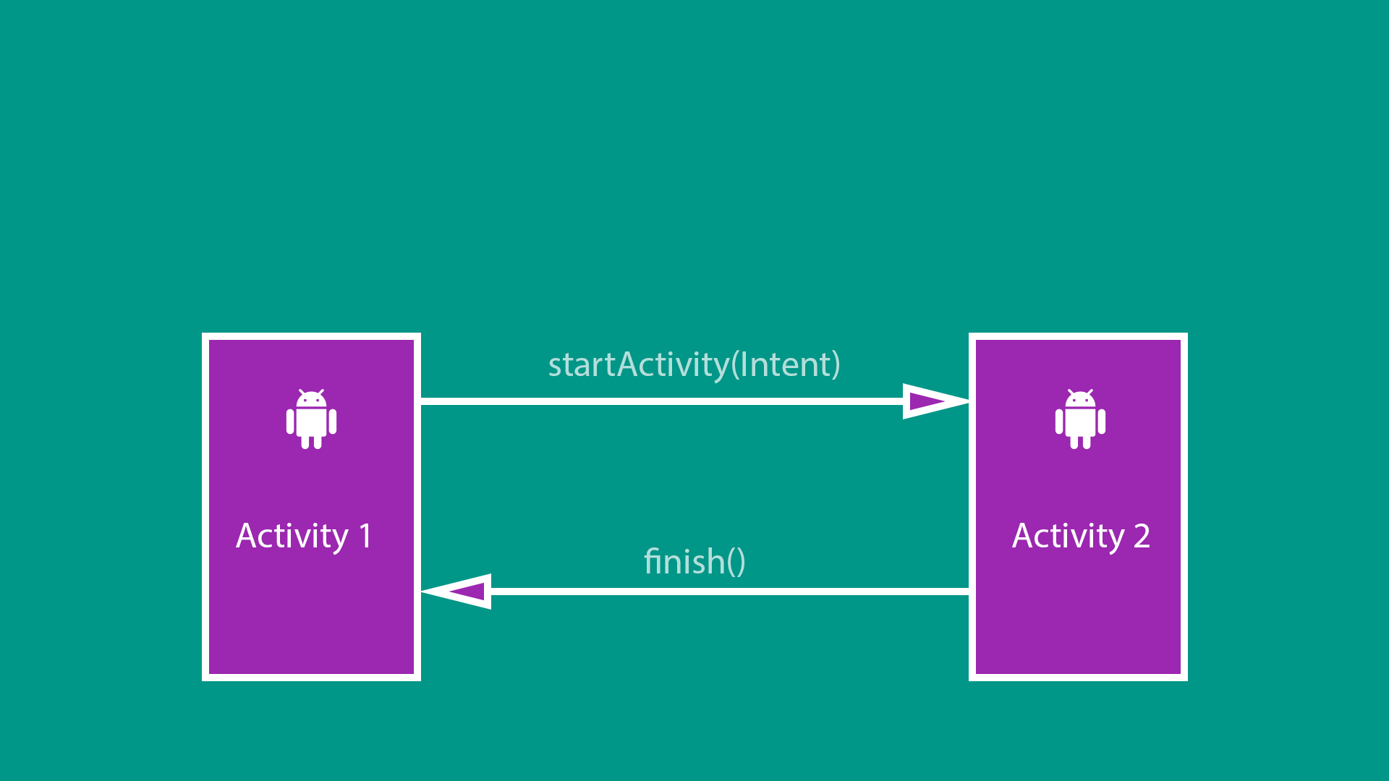
Switch between activities

Slide 19
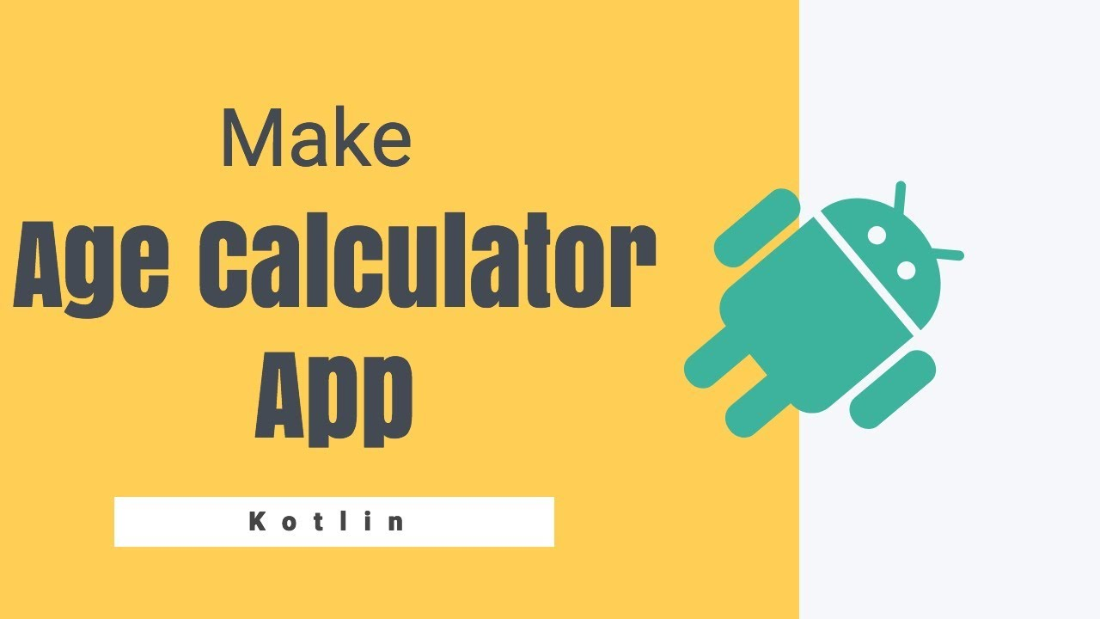
OnCreate
OnStart
OnResume
OnPause
Ontop
OnDestroy

Slide 20
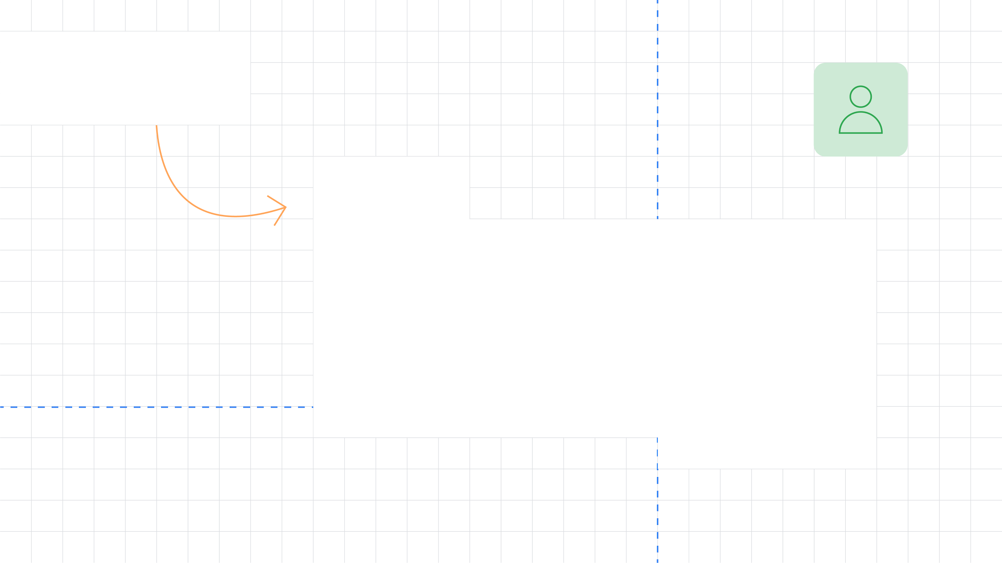
Thank You!
Speaker Name
GDG New York
@twitterhandle

